Slide 1
How to analyse bounded continuous outcomes?
Michail Belias
Department for Health Evidence

Slide 2
How would one perform an analysis with a bounded dependent variable?
Y $∈($a, b) ~ Y $∈($0, 1) (or Y $∈$ [a,b])
Y ∈(a, b) ~ Y ∈(0, 1) (or Y ∈ [a,b])
Transform the data
$\tilde{Y}= h(Y)$ ~ $\tilde{Y}$ $∈$ S ⊆ ℝ
Transform the data
𝑌 ̃= ℎ(𝑌) ~ 𝑌 ̃ ∈ S ⊆ ℝ
logit transformation
Arcsine-square root transformation

Slide 3
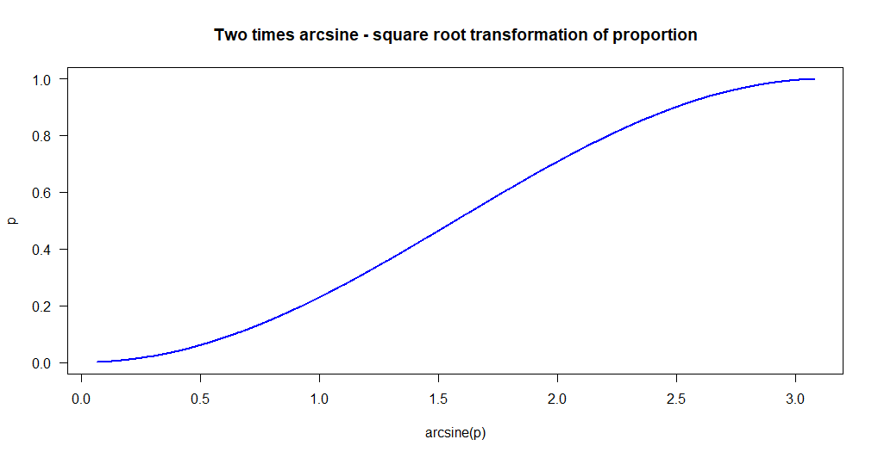
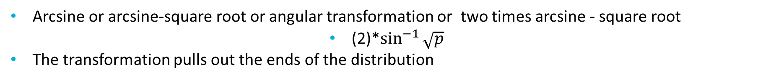
Arcsine-square root transformation
Arcsine or arcsine-square root or angular transformation or two times arcsine - square root
(2)*$\sin^{−1}{\sqrt{p}}$
The transformation pulls out the ends of the distribution

Slide 4
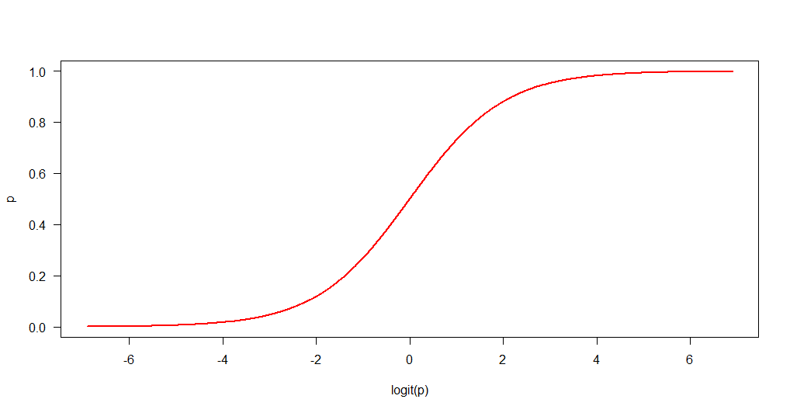
logit transformation
Logit transformation
log(p/1-p)
The transformation pulls out the ends of the distribution more than the arcsine transformation

Slide 5
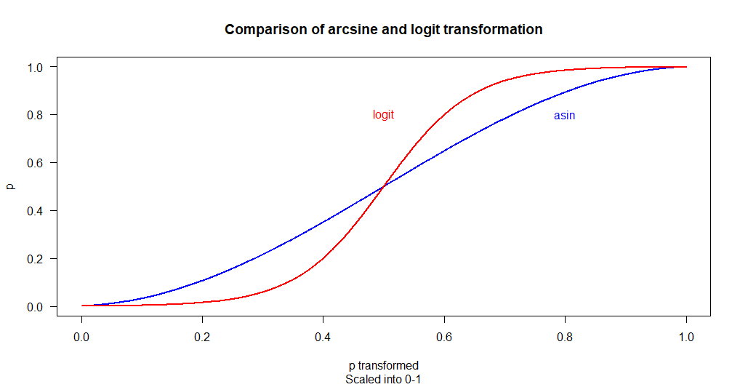
Comparison of effects
The difference in the effect of the transformation is better shown on the same scale

Slide 6
Which one should we choose?
Wilson et al. (2010) and Warton, D.I., and F.K.C. Hui. 2011
Are suggesting the use of logit transformation
The logit scale covers all of the real numbers (important for predictions)
The logit scale is more intuitive
The logit scale correctly models the relationship between the mean and variance in binomial data, where variance is p(1-p)/n.
BUT in some cases the limited range of the arcsine is beneficial (i.e. when zeros and ones are present)
Of course, both transformations are essentially linear over the range of 0.3–0.7, neither transformation is necessary if all of your data fall in this range.
Notes:
The limits of the logit scale are negative infinity and positive infinity.
This is particularly important where prediction is needed, as having a bounded scale could give nonsensical results (e.g., more than 100% or less than 0%).
The logit scale is more intuitive since it is the log-odds.
This is particularly useful in interpreting slopes from a logistic regression, in which the logit transformation is central.
Third, the logit scale correctly models the relationship between the mean and variance in binomial data, where variance is p(1-p)/n.

Slide 7
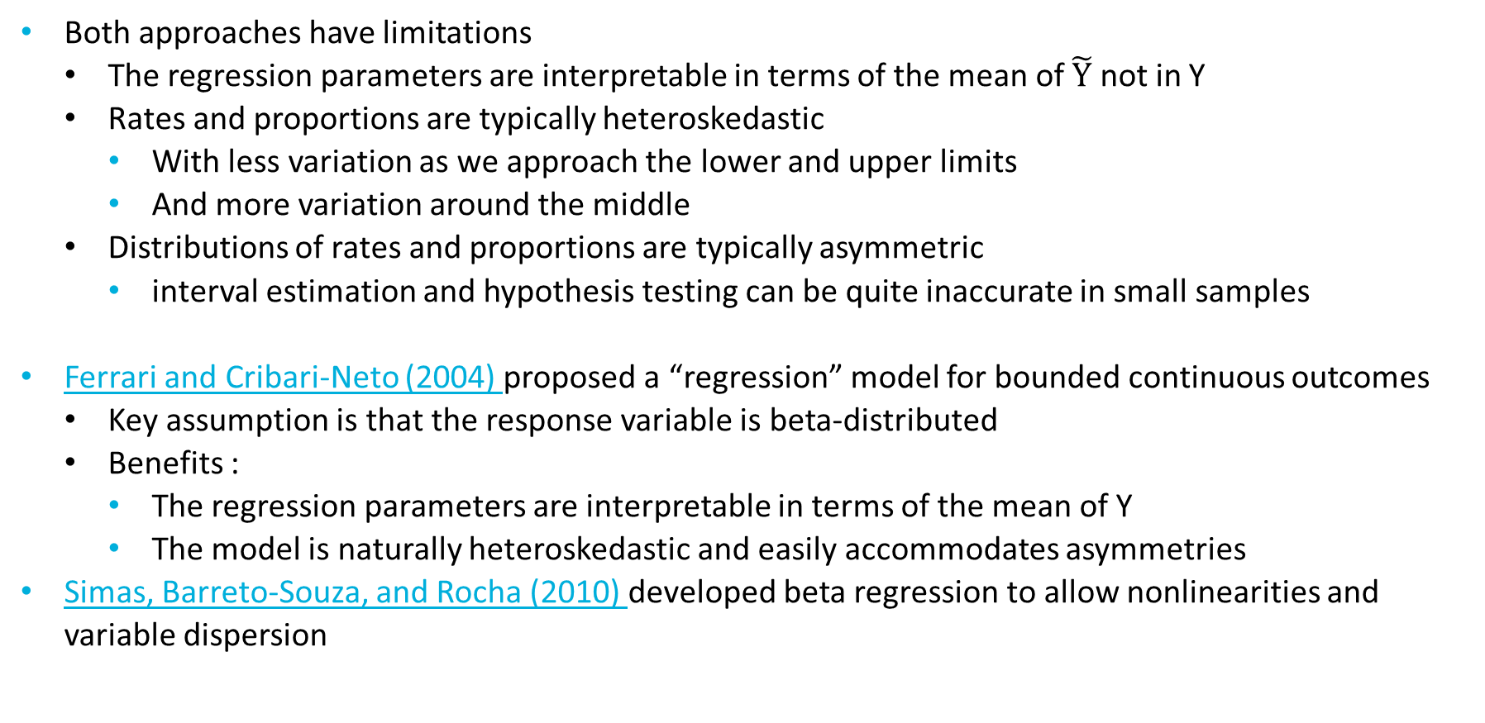
Different point of view
Both approaches have limitations
The regression parameters are interpretable in terms of the mean of $\tilde{Y}$ not in Y
Rates and proportions are typically heteroskedastic
With less variation as we approach the lower and upper limits
And more variation around the middle
Distributions of rates and proportions are typically asymmetric
interval estimation and hypothesis testing can be quite inaccurate in small samples
Ferrari and Cribari-Neto (2004) proposed a “regression” model for bounded continuous outcomes
Key assumption is that the response variable is beta-distributed
Benefits :
The regression parameters are interpretable in terms of the mean of Y
The model is naturally heteroskedastic and easily accommodates asymmetries
Simas, Barreto-Souza, and Rocha (2010) developed beta regression to allow nonlinearities and variable dispersion

Slide 8
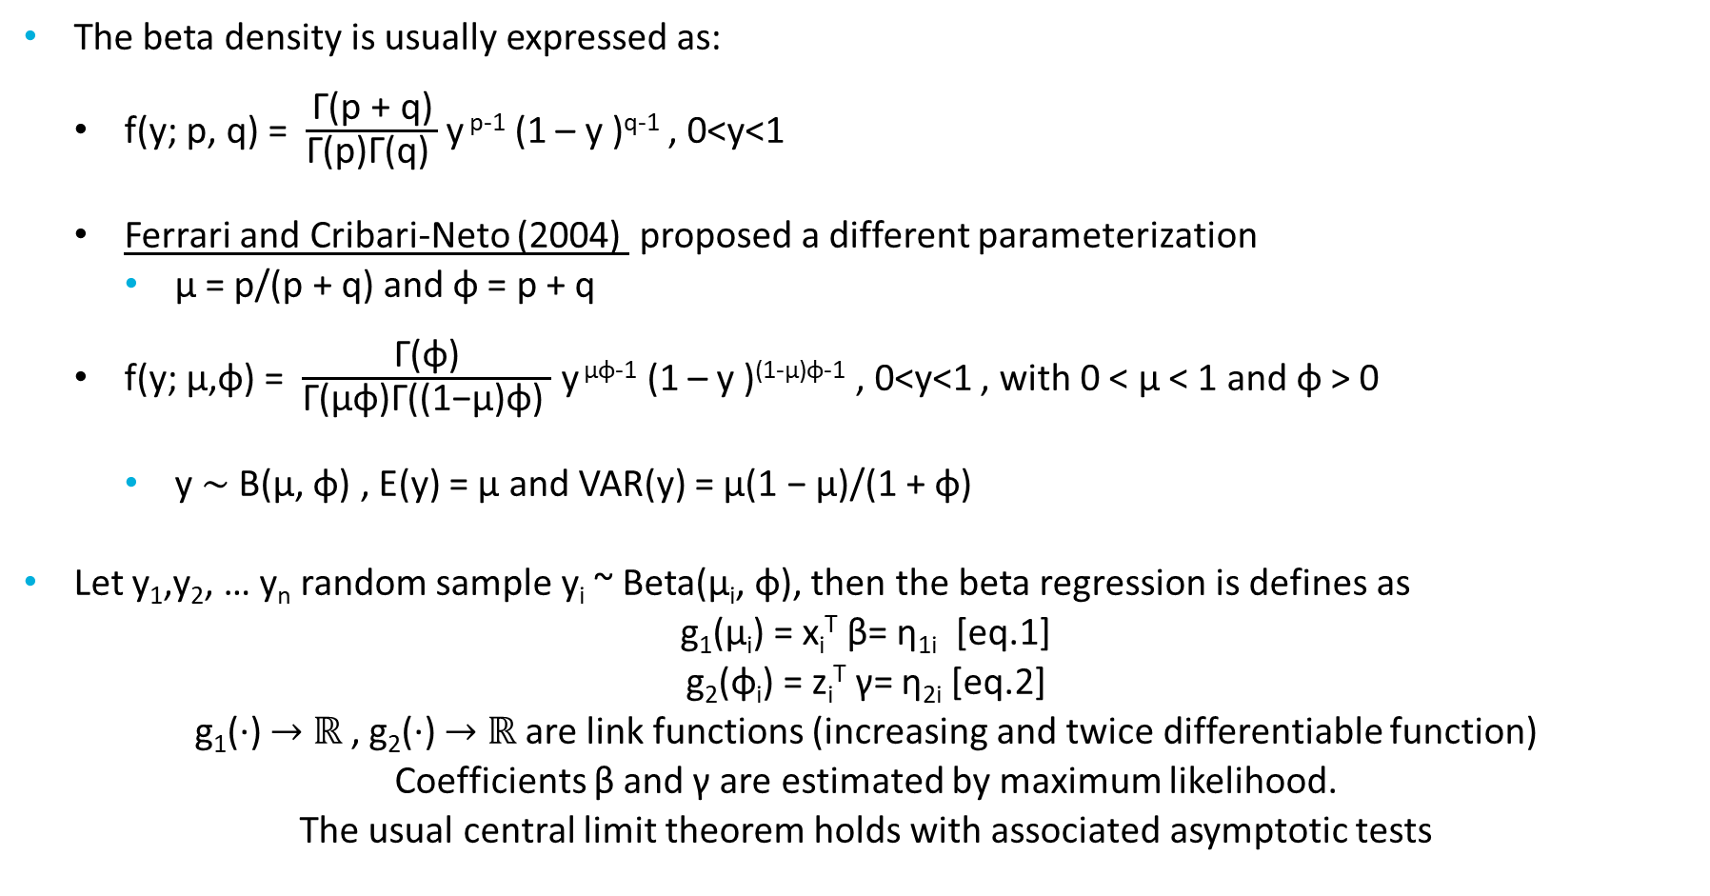
Beta regression models
The beta density is usually expressed as:
f(y; p, q) = $\frac{\text{Γ}\text{(}\text{p}\text{ + }\text{q}\text{)}}{\text{Γ}\text{(}\text{p}\text{)}\text{Γ}\text{(}\text{q}\text{) }}$ y ^{p-1} (1 – y )^{q-1} , 0<y<1
Ferrari and Cribari-Neto (2004) proposed a different parameterization
µ = p/(p + q) and φ = p + q
f(y; μ,φ) = $\frac{\text{Γ}\text{(}\text{φ}\text{)}}{\text{Γ}\text{(}\text{μφ}\text{)}\text{Γ}\text{(}\text{(1−}\text{μ}\text{)}\text{φ}\text{) }}$ y ^{μφ-1} (1 – y )^{(1-μ)φ-1} , 0<y<1 , with 0 < µ < 1 and φ > 0
y ∼ B(µ, φ) , E(y) = µ and VAR(y) = µ(1 − µ)/(1 + φ)
Let y₁,y₂, … y_{n} random sample y_{i} ~ Beta(μ_{i}, φ), then the beta regression is defines as
g₁(μ_{i}) = x_{i}^{T} β= η_{1i} [eq.1]
g₂(φ_{i}) = z_{i}^{T} γ= η_{2i} [eq.2]
g₁(·) $→$ ℝ , g₂(·) $→$ ℝ are link functions (increasing and twice differentiable function)
Coefficients β and γ are estimated by maximum likelihood.
The usual central limit theorem holds with associated asymptotic tests
Notes:
The main motivation for using a link function in the regression structure is twofold.
First, both sides of the regression equation assume values in the real line when a link function is applied to i.
Second, there is an added flexibility since the practitioner can choose the function that yields the best fit.
log, logit , probit , complementary log-log, log-log and Cauchy for the mean
"identity", "log", and "sqrt“ for the precision.

Slide 9
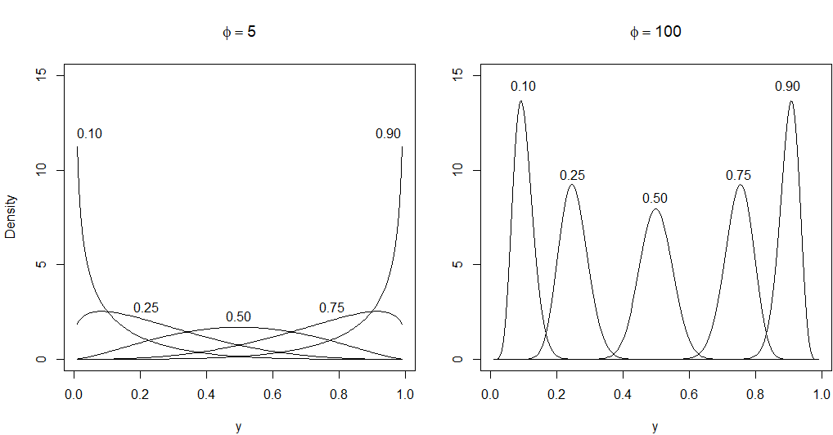
Beta distribution
Probability density functions for beta distributions with varying parameters

Slide 10
Implementation in R
The function used is betareg()
Similar to the glm() function.
A main difference is that two equations may be calculated (one for mean and one for precision)
formula = y ~ x1 + x2 | z1 + z2 + z3
In the above example the x₁ + x₂ are the regressors for mean modelling [eq.1]
While the z₁ + z₂ + z₃ are the regressors for the precision equation [eq.2]
formula = y ~ x1 + x2

Slide 11
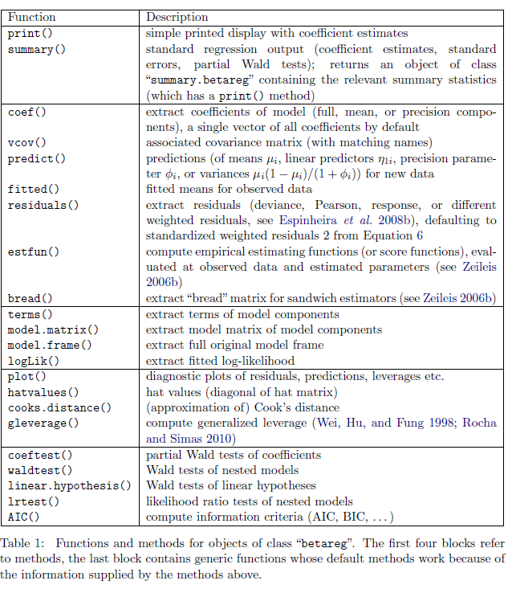

Slide 12
Examples
Reading accuracy data for nondyslexic and dyslexic Australian children (Smithson and Verkuilen 2006)
We model the reading accuracy given dyslexia and IQ with interaction
arcsine transformation
Estimate Std. Error t value Pr(>|t|)
(Intercept) 1.071217 0.029041 36.8862 < 2.2e-16 ***
dyslexia -0.188236 0.029041 -6.4817 9.946e-08 ***
iq 0.041216 0.028993 1.4216 0.16290
dyslexia:iq -0.056415 0.028993 -1.9458 0.05872 .
logit transformation
Estimate Std. Error t value Pr(>|t|)
(Intercept) 1.60107 0.22586 7.0888 1.411e-08 ***
dyslexia -1.20563 0.22586 -5.3380 4.011e-06 ***
iq 0.35945 0.22548 1.5941 0.11878
dyslexia:iq -0.42286 0.22548 -1.8754 0.06805 .
Both interactions were statistically not significant

Slide 13
Examples (continued)
When overdispersion is accounted the interactions become significant
Estimate Std. Error z value Pr(>|z|)
(Intercept) 1.12323 0.15089 7.4441 9.758e-14 ***
dyslexia -0.74165 0.15145 -4.8969 9.736e-07 ***
iq 0.48637 0.16708 2.9109 0.0036034 **
dyslexia:iq -0.58126 0.17258 -3.3681 0.0007568 ***
(phi)_(Intercept) 3.30443 0.22650 14.5890 < 2.2e-16 ***
(phi)_dyslexia 1.74656 0.29398 5.9410 2.832e-09 ***
(phi)_iq 1.22907 0.45957 2.6744 0.0074862 **
---
Signif. codes: 0 ‘***’ 0.001 ‘**’ 0.01 ‘*’ 0.05 ‘.’ 0.1 ‘ ’ 1

Slide 14
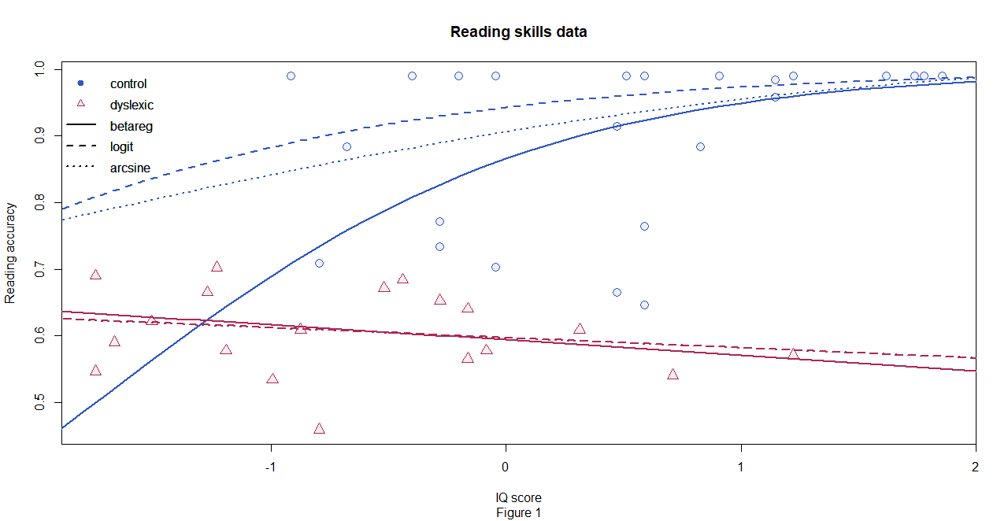
How do the models fit?

Slide 15
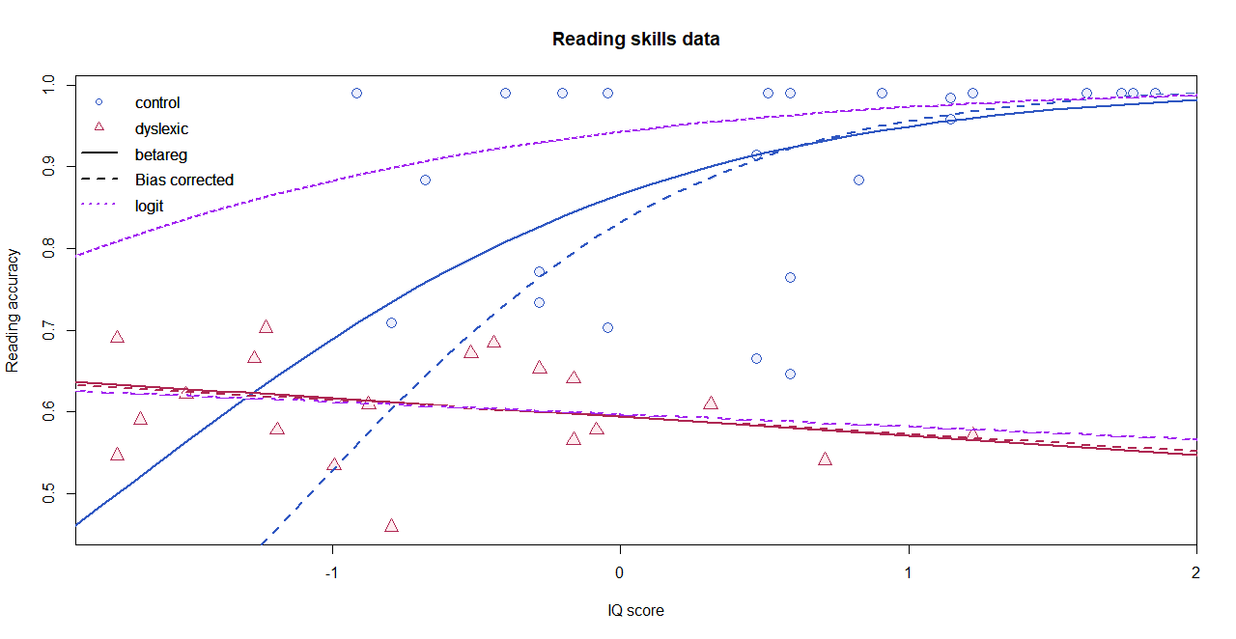
Care on the ML estimation
Kosmidis and Firth (2010) showed that ML inference may be severely biased in the context of beta regression
Therefore, bias corrected and bias reduced addons are imported and called through the option
type = c("ML", "BC", "BR")

Slide 16
Small bonuses
Beta regression trees are also possible using the betatree function a modified glmtree from partykit package. Zeileis A, Hothorn T, Hornik K (2008)
The MOB (Model based recursive partitioning) approach:
Fitting a beta regression model
Assessing whether its parameters are stable across all partitioning variables
Splitting the sample along the partitioning variable associated with the highest parameter instability
Repeating these steps until some stopping criterion is met

Slide 17
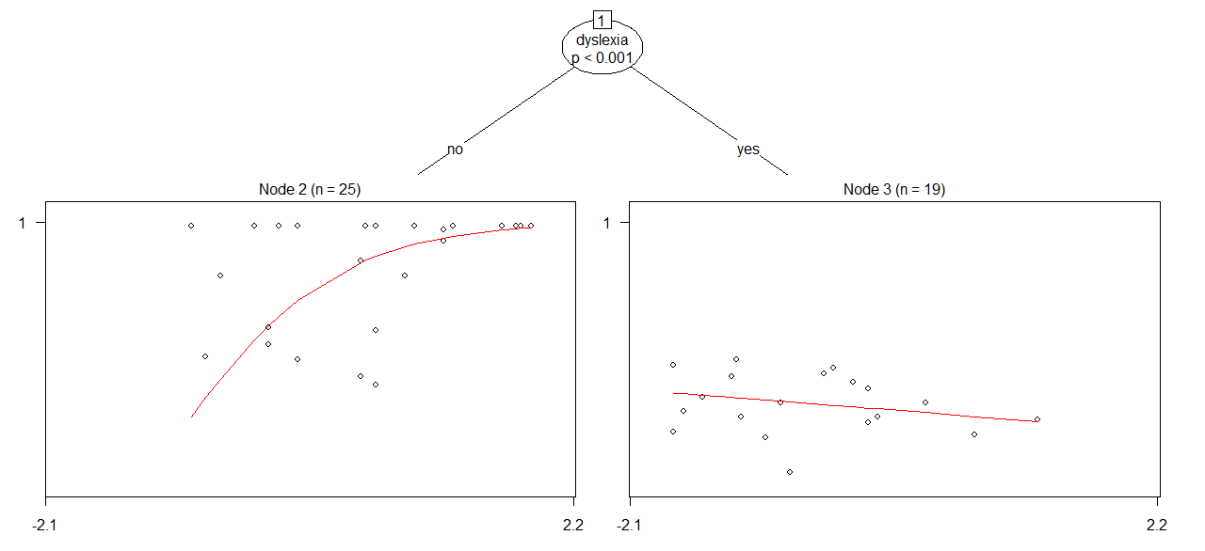
Betatree

Slide 18
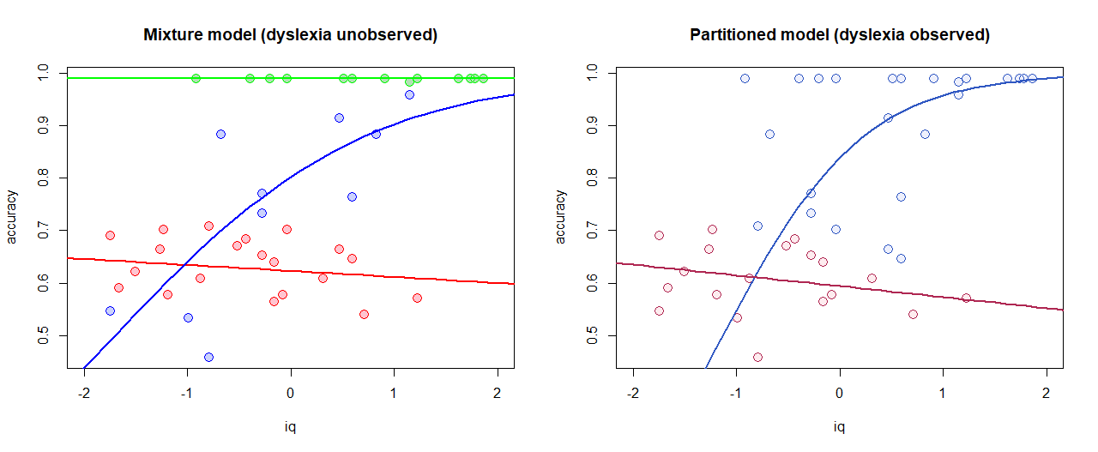
Latent class beta regression
No dyslexia information available.
Look for k = 3 clusters with at least a component for ideal score of 0.99

Slide 19
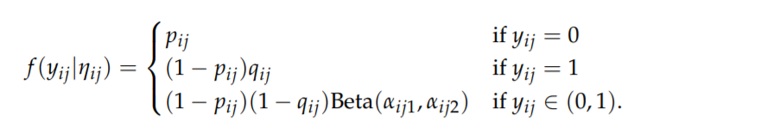
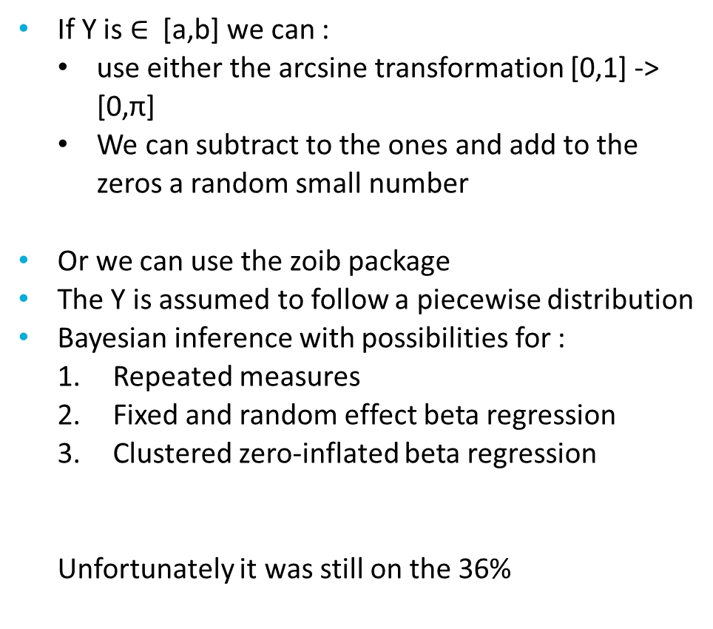
Finally
If Y is $∈$ [a,b] we can :
use either the arcsine transformation [0,1] -> [0,π]
We can subtract to the ones and add to the zeros a random small number
Or we can use the zoib package
The Y is assumed to follow a piecewise distribution
Bayesian inference with possibilities for :
Repeated measures
Fixed and random effect beta regression
Clustered zero-inflated beta regression
Unfortunately it was still on the 36%

Slide 20
References
[1] Warton, D.I., and F.K.C. Hui. 2011. The arcsine is asinine: the analysis of proportions in ecology. Ecology 92:3–10.
[2] Wilson, E., Underwood, M., Puckrin, O., Letto, K., Doyle, R., Caravan, H., Camus, S., & Bassett, K. (2010). The Arcsine Transformation: Has the time come for retirement? http://www.mun.ca/biology/dschneider/b7932/B7932Final10Dec2010.pdf
[3] Silvia Ferrari & Francisco Cribari-Neto (2010) Beta Regression for Modelling Rates and Proportions, Journal of Applied Statistics, 31:7, 799-815, DOI: 10.1080/0266476042000214501
[4] Simas, Alexandre & Barreto-Souza, Wagner & V. Rocha, Andréa. (2010). Improved estimators for a general class of beta regression models. Computational Statistics & Data Analysis. 54. 348-366. 10.1016/j.csda.2009.08.017.
[5] Kosmidis I, Firth D (2010). \A Generic Algorithm for Reducing Bias in Parametric Estimation.“ Electronic Journal of Statistics, 4, 1097{1112.
[6] Zeileis A, Hothorn T, Hornik K (2008). “Model-Based Recursive Partitioning.” Journal of Computational and Graphical Statistics, 17(2), 492–514. doi:10.1198/106186008X319331

